Slide 1
人工智能引论
宋睿华
中国人民大学人工智能学院

Slide 2
人工智能与语言
语言模型概述
词向量表示
递归神经网络
条件语言模型
预训练模型

Slide 3
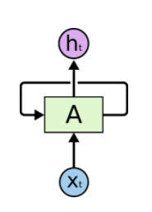
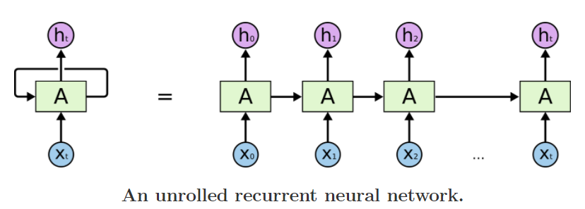
Recurrent Neural Network （RNN）

Slide 4
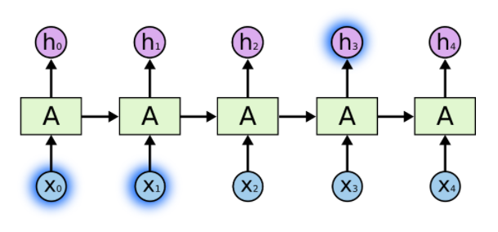
Short-Term Dependencies
e.g., the cloud is in the sky
e.g., the sky is (blue)

Slide 5
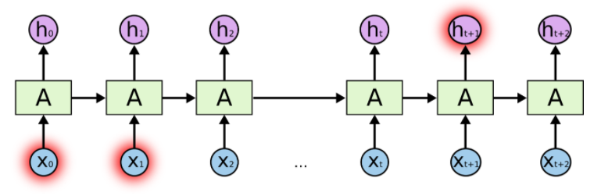
The Problem of Long-Term Dependencies
e.g., I grew up in France. … I speak fluent (French)
e.g., the sky is (blue)

Slide 6
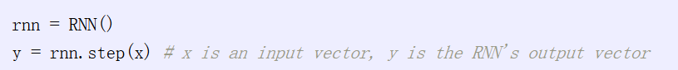
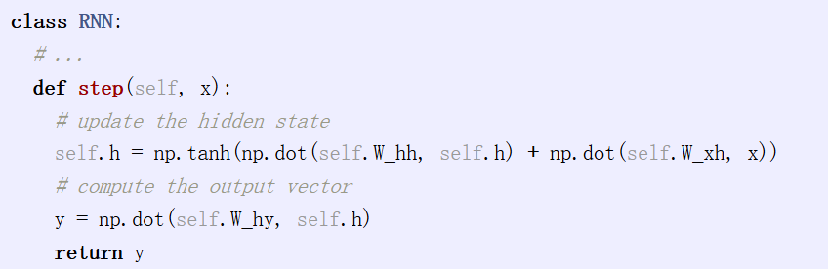
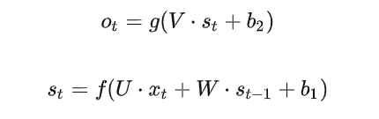
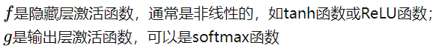
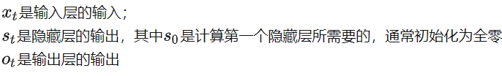
RNN公式表达

Slide 7

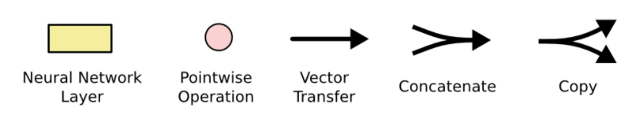
Recurrent Neural Networks
https://colah.github.io/posts/2015-08-Understanding-LSTMs/

Slide 8
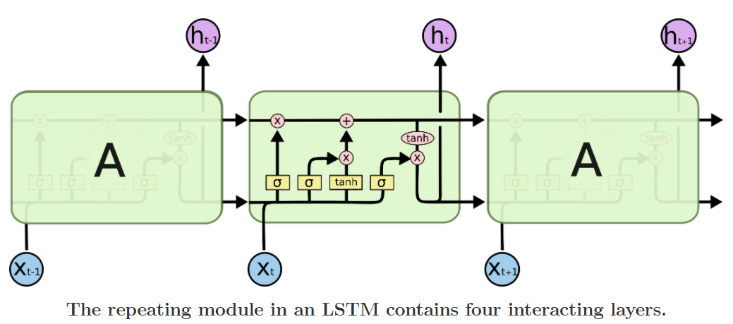
Long Short Term Memory Networks
https://colah.github.io/posts/2015-08-Understanding-LSTMs/

Slide 9
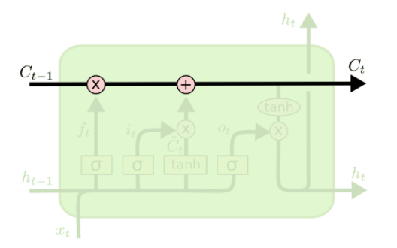
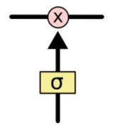
Step-by-Step LSTM Walk Through
The cell state is kind of like a conveyor belt
Gate
https://colah.github.io/posts/2015-08-Understanding-LSTMs/

Slide 10
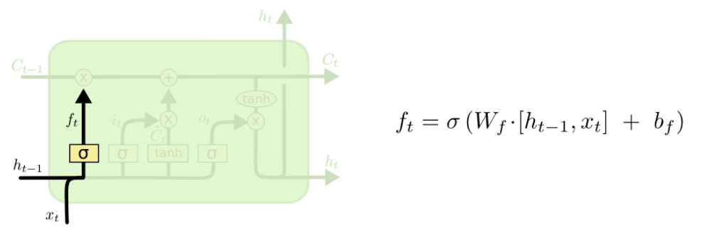
Step-by-Step LSTM Walk Through
An example of “forget gate”: when we see a new subject, we want to forget the gender of the old subject
https://colah.github.io/posts/2015-08-Understanding-LSTMs/

Slide 11
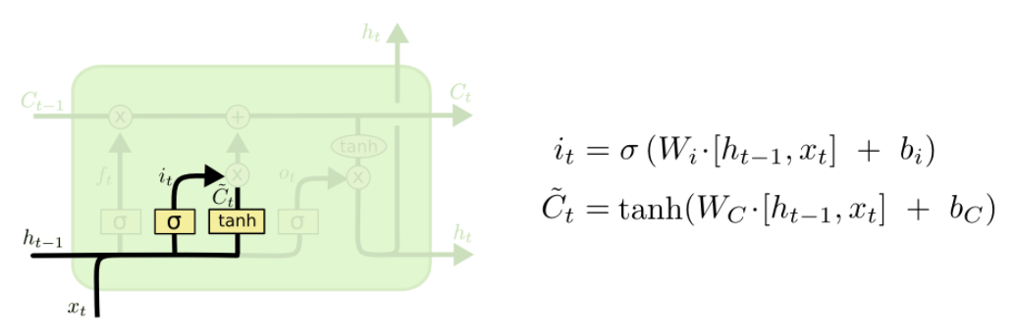
Step-by-Step LSTM Walk Through
An example of “input gate”: we’d want to add the gender of the new subject to the cell state
https://colah.github.io/posts/2015-08-Understanding-LSTMs/

Slide 12
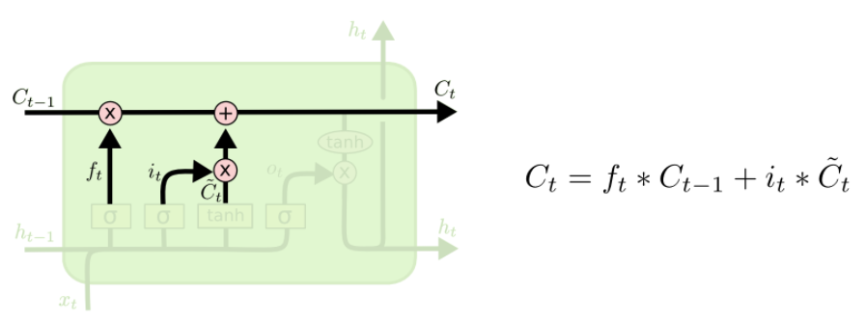
Step-by-Step LSTM Walk Through
An example of “update gate”: we’d actually drop the information about the old subject’s gender and add the new information
https://colah.github.io/posts/2015-08-Understanding-LSTMs/

Slide 13
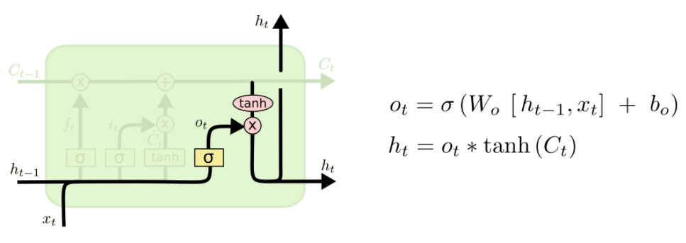
Step-by-Step LSTM Walk Through
An example of “output gate”: it might output whether the subject is singular or plural, so that we know what form a verb should be conjugated into if that’s what follows next
https://colah.github.io/posts/2015-08-Understanding-LSTMs/

Slide 14
Long Short Term Memory Networks
https://colah.github.io/posts/2015-08-Understanding-LSTMs/

Slide 15
3. 语言模型-神经网络语言模型
RNN发展历程：
1987. RNN: Robinson Fallside, 1987; Werbos, 1988; Williams, 1989;
1997. LSTM: Hochreiter Schmidhuber
1997. BRNN: Schuster, Paliwal
2000. Forget gate: Gers, Schmidhuber, and Cummins
Peephole Connection: Gers
2005. BiLSTM: Graves, Schmidhuber
2014. GRU: Cho
2016. Minimal GRU: Sun, Liu, Lau

Slide 16
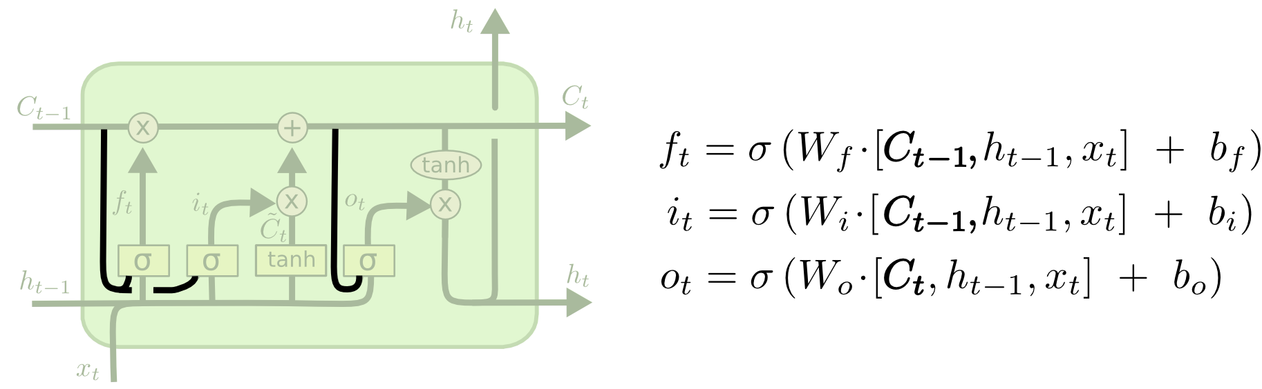
Variants of LSTM: Peephole

Slide 17
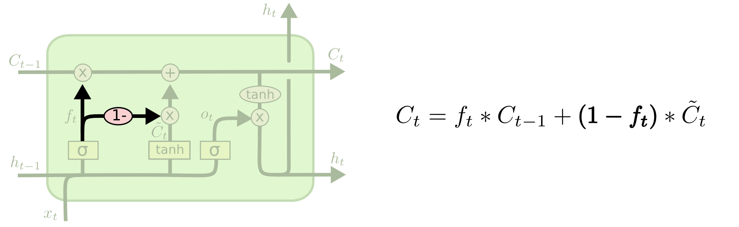
Variants of LSTM: Coupled forget and input gate

Slide 18
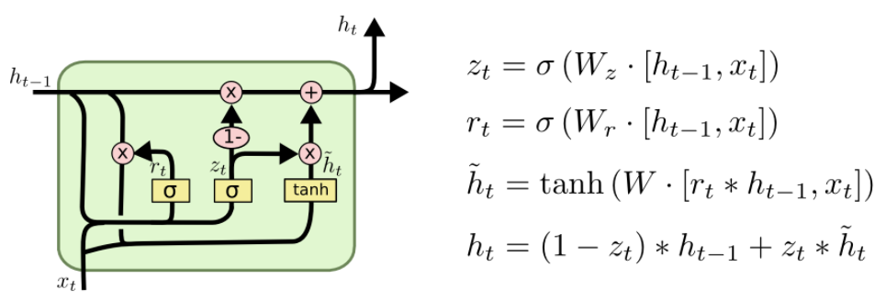
Variants of LSTM: Gated Recurrent Unit

Slide 19
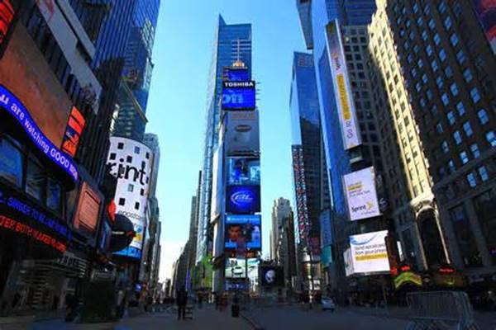
应用举例
像每一座城市愧对乡村 我才有一个美好的完成 每个失眠的夜晚我是一个花言巧语的人 隐匿在灵魂最迷失的火
绕出城市的边缘
美好的
在风里
最轻微的触动

Slide 20

生成的诗（1）
游子是一只船上的沙土 如同美丽的灵魂 我不能创造世界 伴着古老之遗恨
//有点忧伤

Slide 21
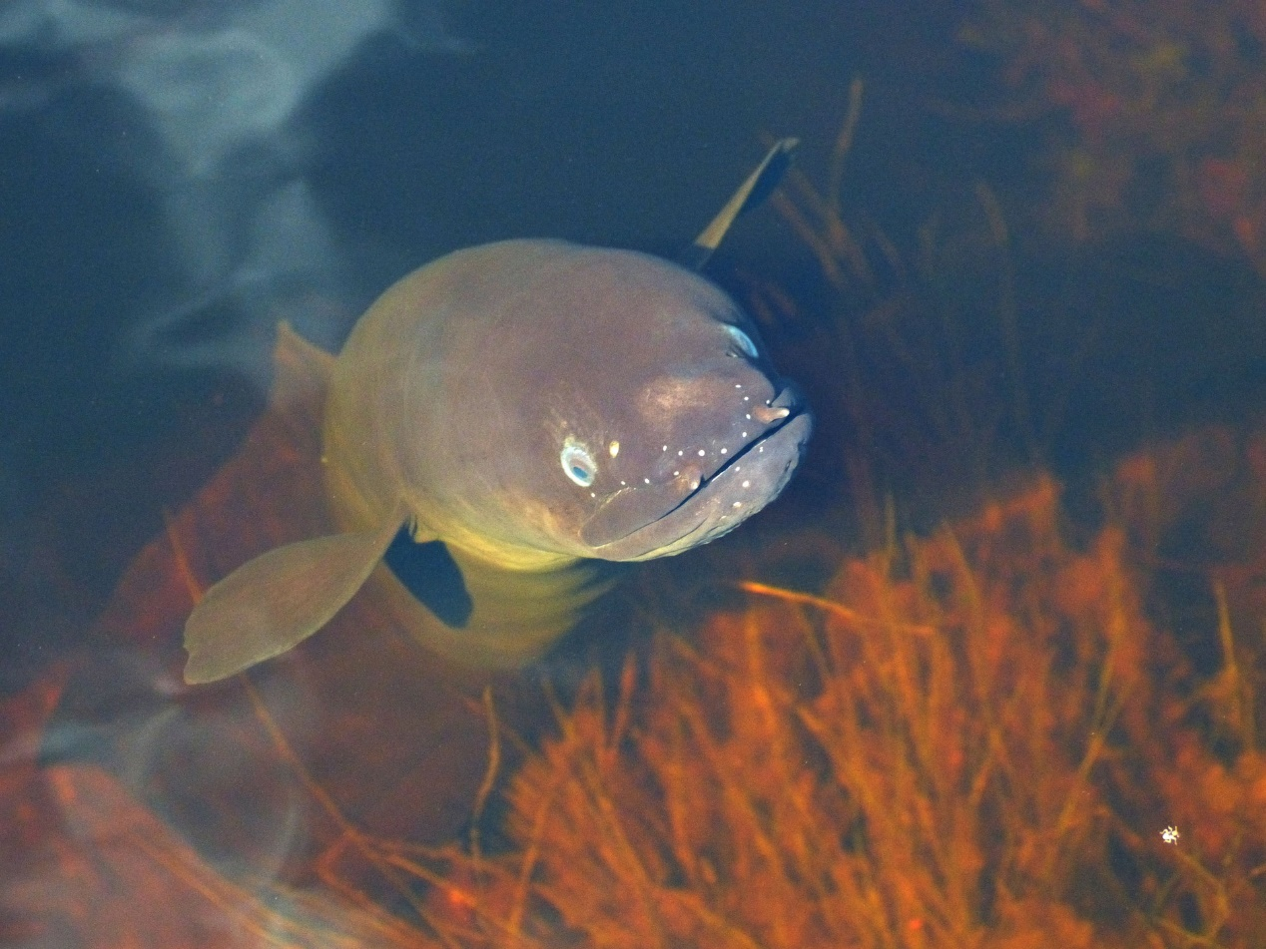
生成的诗（2）
鱼的人 甜蜜的风 灵魂的呼吸 那最高的天空
//队形很好，你逗我的吧？

Slide 22
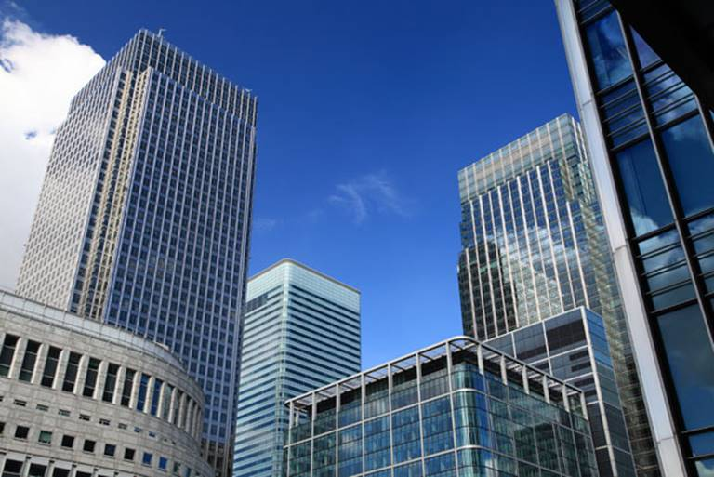
生成的诗（3）
所有的城市愧对你强大的数字 美好的希望 最好的朋友心爱的老婆 大风起来
//那数字难道是GDP?

Slide 23
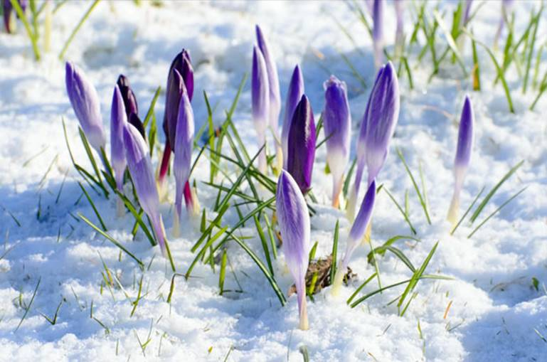
生成的诗（4）
在花里表演 扬起明亮的羽毛 静静地翕动着 所有生命的期限
Notes:
In this image, some flowers are in the snow. Unfortunately, algorithms cannot recognize snow, or at least snow is not the top one recognized object. However, the generated poem is like this:
Perform in flowers
Raise bright feathers
Moved quietly
The duration of all life
It happens that the poem uses an advanced skill. It describes snow but without mentioning it at all. This poem is what I love most.

Slide 24
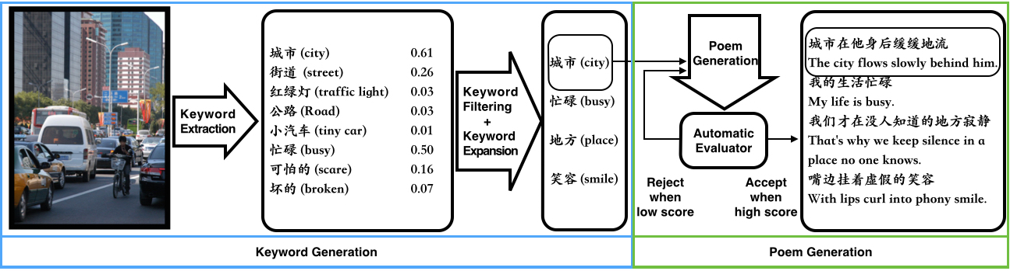
图像激发灵感的诗歌生成
Notes:
Next, I’d like give you some simple explanation on the algorithm behind.
Our problem is starting with image and outputting a poem. As shown in this flowchart, we extract keywords first: some are nouns or objects and some are adjectives or sentiments. In this image, the top object is city and the top sentiment is busy. So we pick these two words as keywords.
Then we extend two more keywords from counting the co-occurrences of words with city in human written poems for training. In this case, we get place and smile.
Next, we use a module to generate poems and automatic evaluator to reject the sentences with too much faults.
Finally, we get a poem like this:
The city flows slowly behind him
My life is busy
That’s why we keep silence in a place no one knows
With lips curl into phony smile

Slide 25
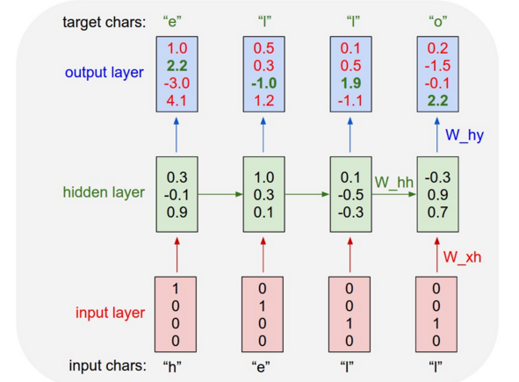
基于字符的递归神经元网络模型
http://karpathy.github.io/2015/05/21/rnn-effectiveness/
Notes:
Our core generation algorithm is based RNN. This chart is borrowed from Karpathy’s blogs. It explains how an RNN mode looks like.
We do not need any labels in training an RNN language model. It targets to predict next character. For example, “hello” is a word for training. The input is h, e, l, and l. The target output chars are e, l, l, and o. We use a one-hot vector to denote the input character. Then the weights in the hidden layer are learned to decrease the error-rate of outputs. For example, e is the target character, but the biggest dimension of output shall be the second, but it is not at this time. Through more training, more and more outputs can match the targets.

Slide 26
如何生成一句话
Forward RNN Model
（换行符）
城市
在
他
身
后
缓缓地
流
（换行符）
Backward RNN Model
Notes:
In previous works, it usually takes the input keyword as the first word and then generate the remaining part. We trained two models: one forward RNN model and one backward RNN model. Thus the keyword can appear in any place of the sentence. It is more flexible.

Slide 27
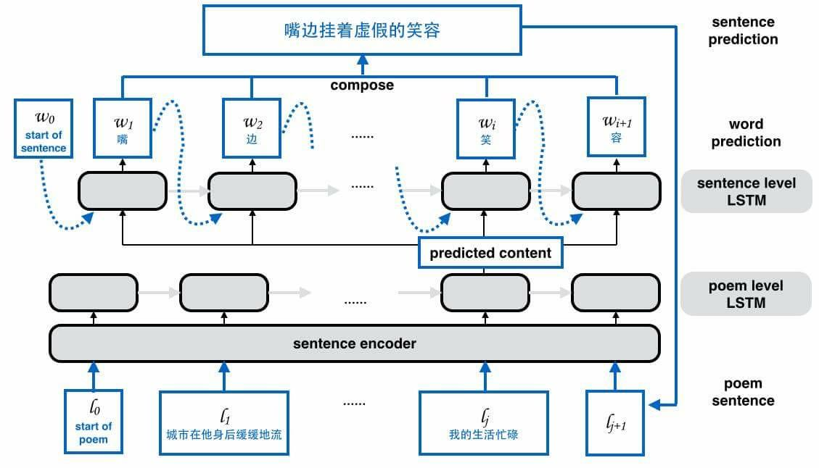
如何生成一首诗
Notes:
In generating the next sentence, we consider both the word and the previous sentences. We use an LSTM to predict the embedding of next sentence. Then use it as additional input in generate words in this sentence.

Slide 28
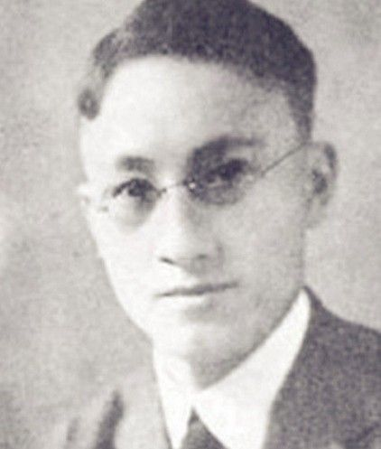
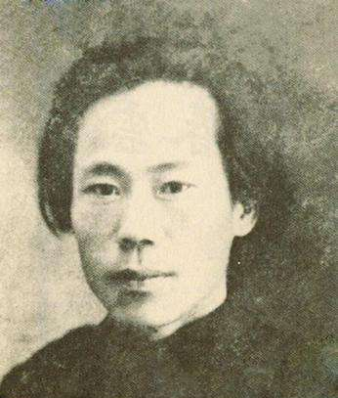
可以创作有风格的诗歌吗？
《涡堤孩新婚歌》
德国作家莫特·福凯
徐志摩 译
……
绕一个梅花岛，画几个美人涡，
流出了山峡口，流入了大海波，
笑呼呼的轻唱一回新婚歌，
“开门，水晶的龙官，
涡堤孩已经成功，
她嫁了一个美丽的丈夫，
取得了她的灵魂整个。”
《影》
于赓虞
看，那秋叶在明媚的星月下正飘零，
与你邂逅相逢于此残秋荒岸之夜中，
星月分外明，忽聚忽散的云影百媚生。
看，那秋叶在明媚的星月下正飘零，
我沦落海底之苦心在此寂寂的夜茔
将随你久别的微笑从此欢快而光明
……

Slide 29
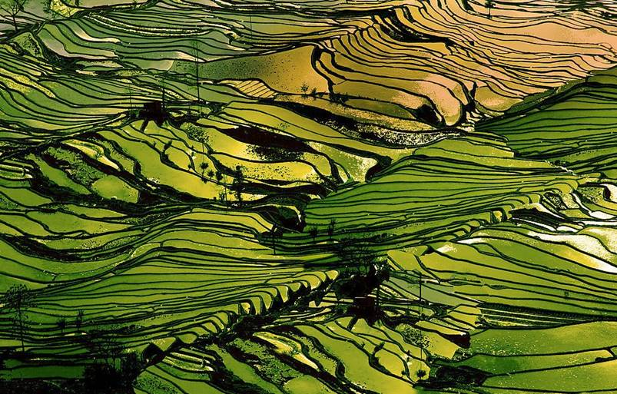
听他们的画声和呼唤
一桩桩更鲜艳的青春
所有的声音恣意的流过
如今安眠在这大地里
也难将他的怪事描绘画了我的心
即是我可怜青春的悲哀
休息于风霜中间的墓台
这生命的残雪狼藉之骸

Slide 30
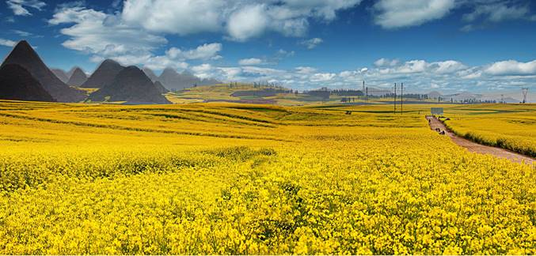
荒草地上飘零的孤影
从暗苍的天幕我见你美丽的蔷薇
撒一把灰烟在神的脚下的灰色的挽歌
我和孤弦歌唱求欢
这时代的秘密
她嫁了一个美丽的灵魂
假如你我创一个完全的梦境了
追尽了生命的经纬脉络

Slide 31
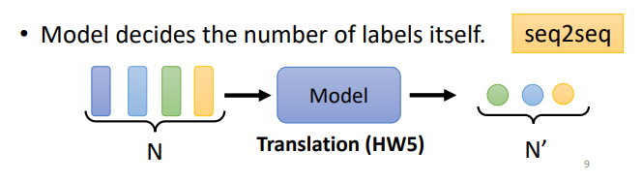
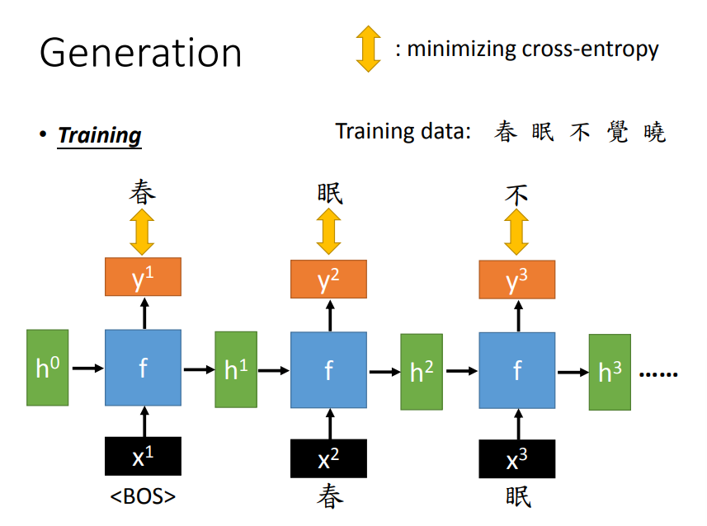
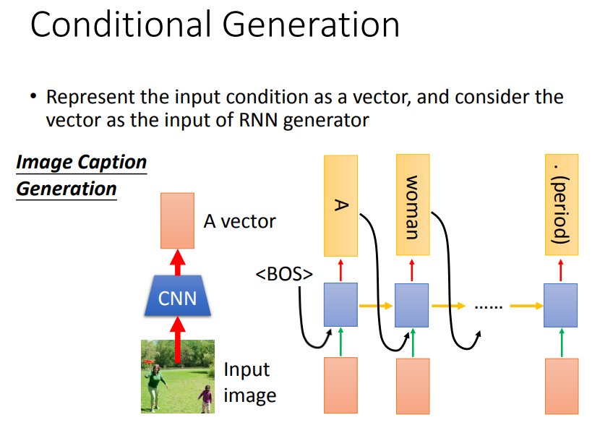
条件语言模型
Seq2seq:

Slide 32
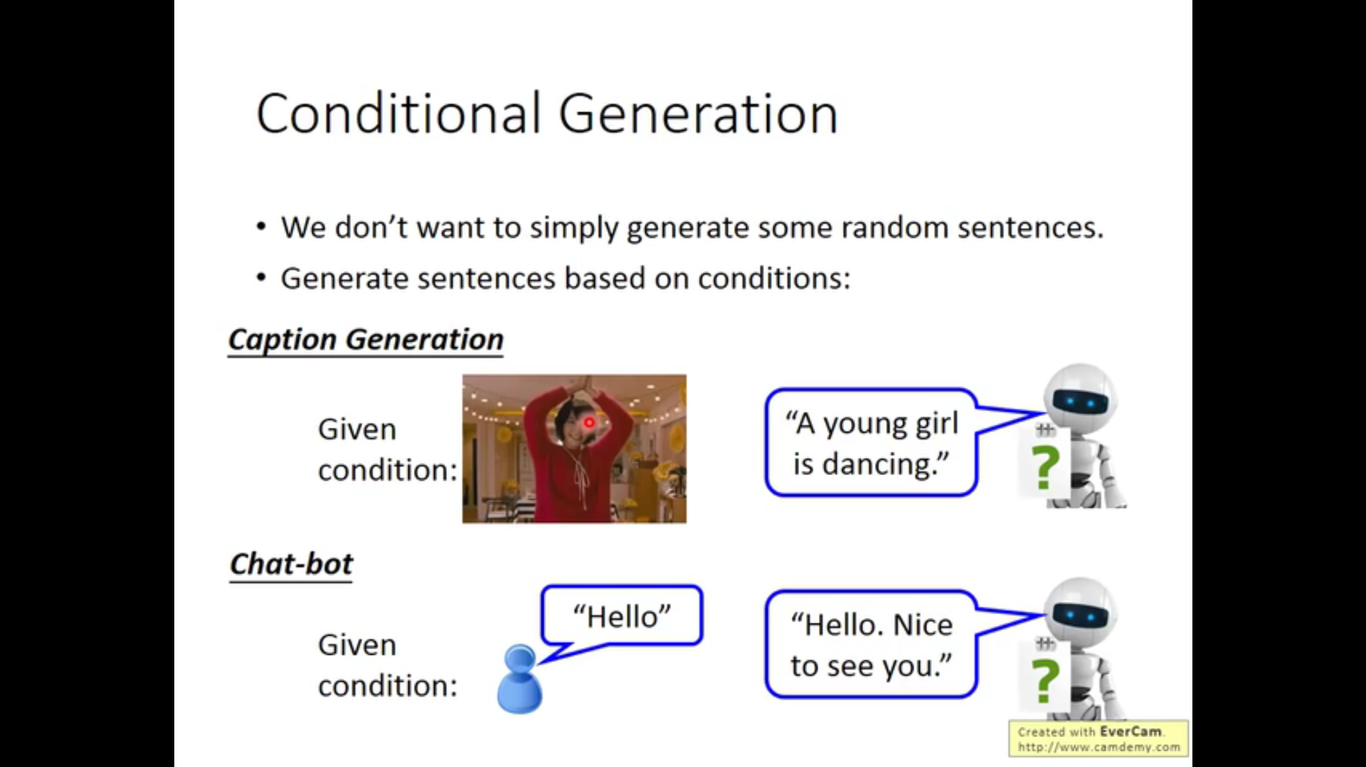

Slide 33
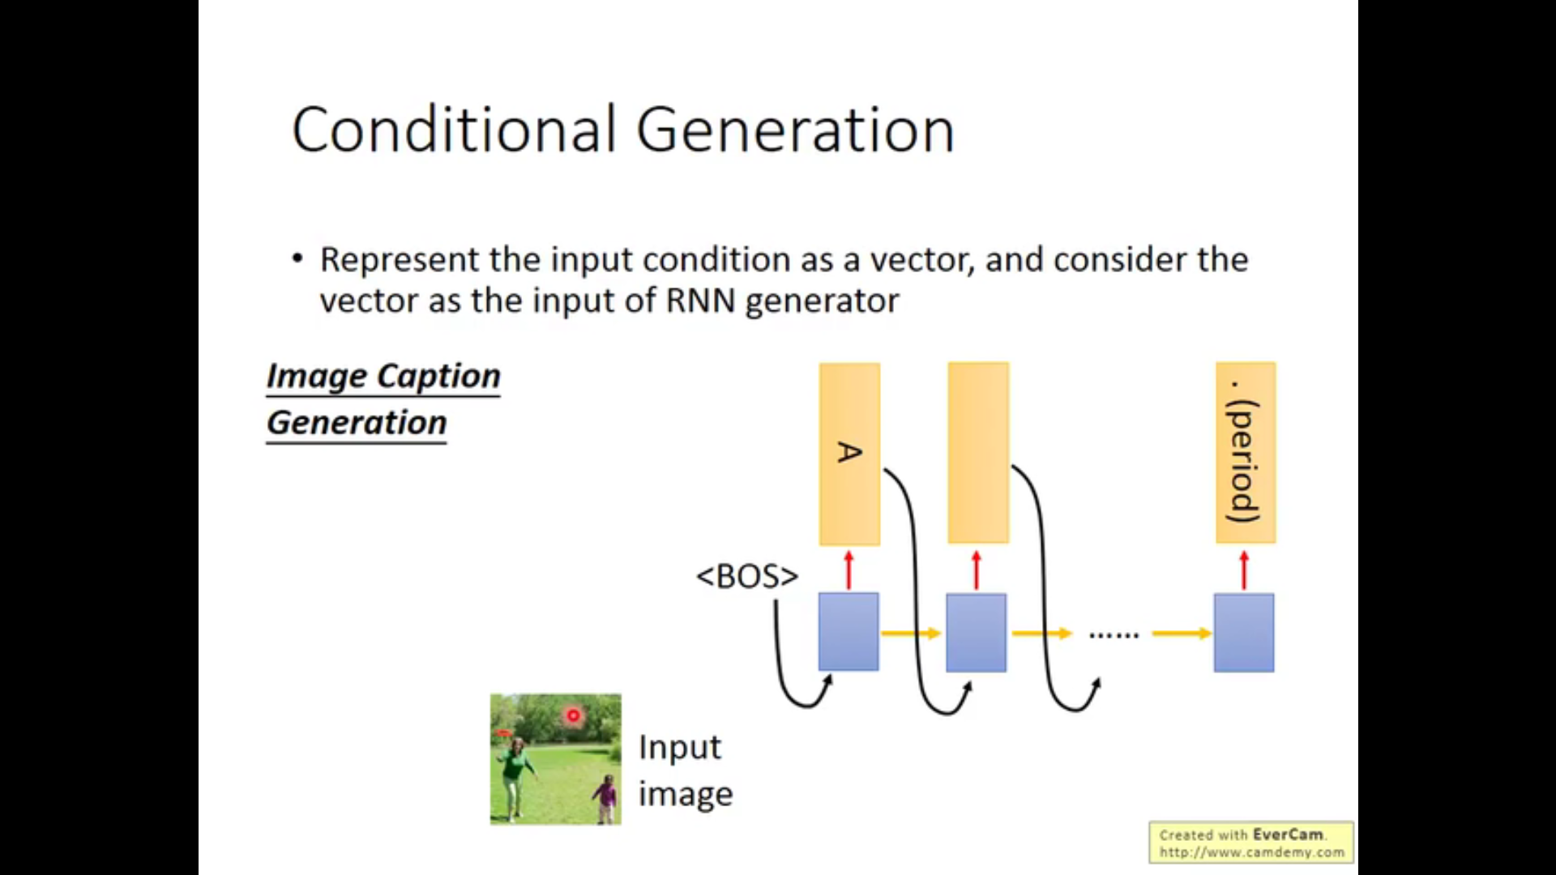

Slide 34
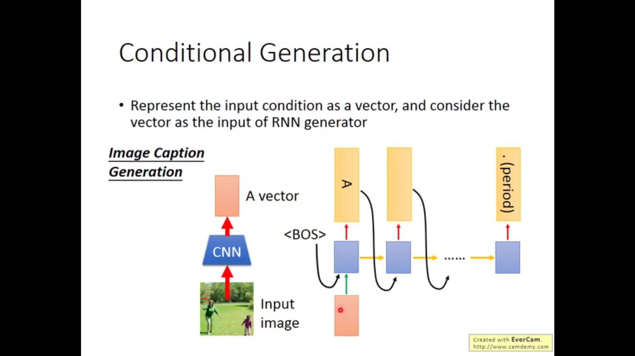

Slide 35
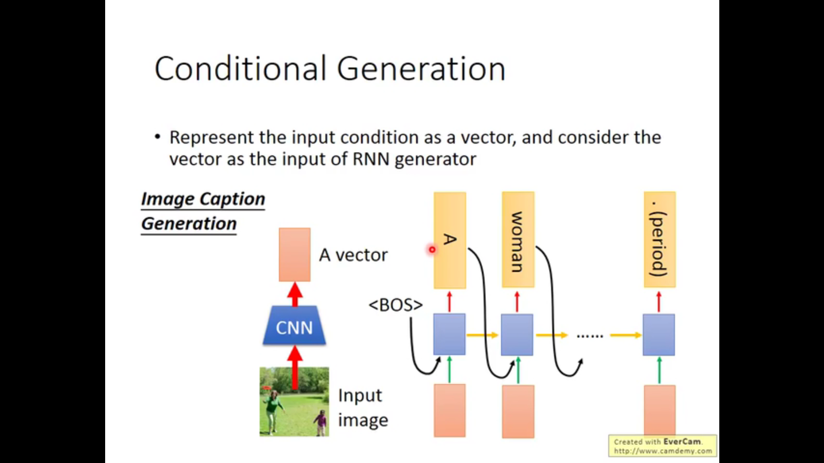

Slide 36
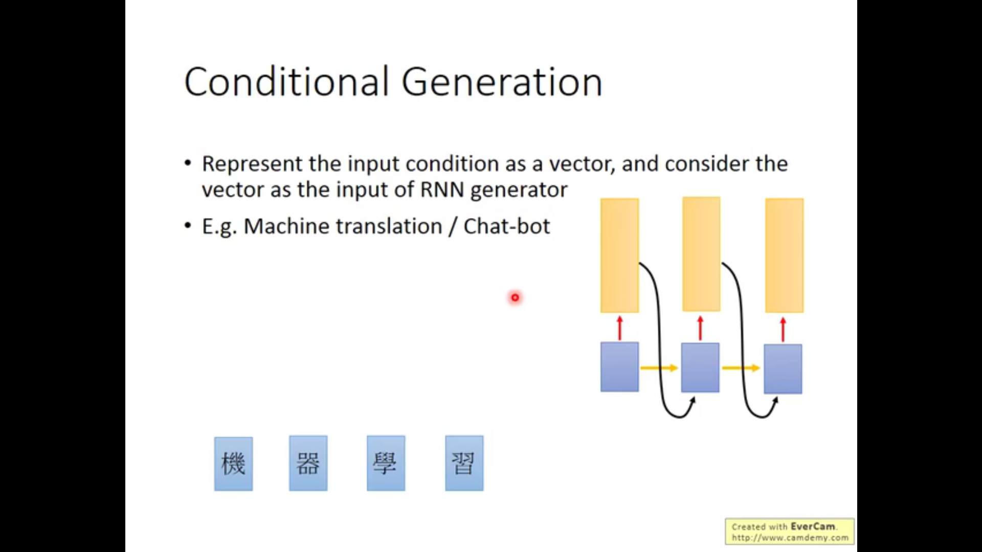

Slide 37
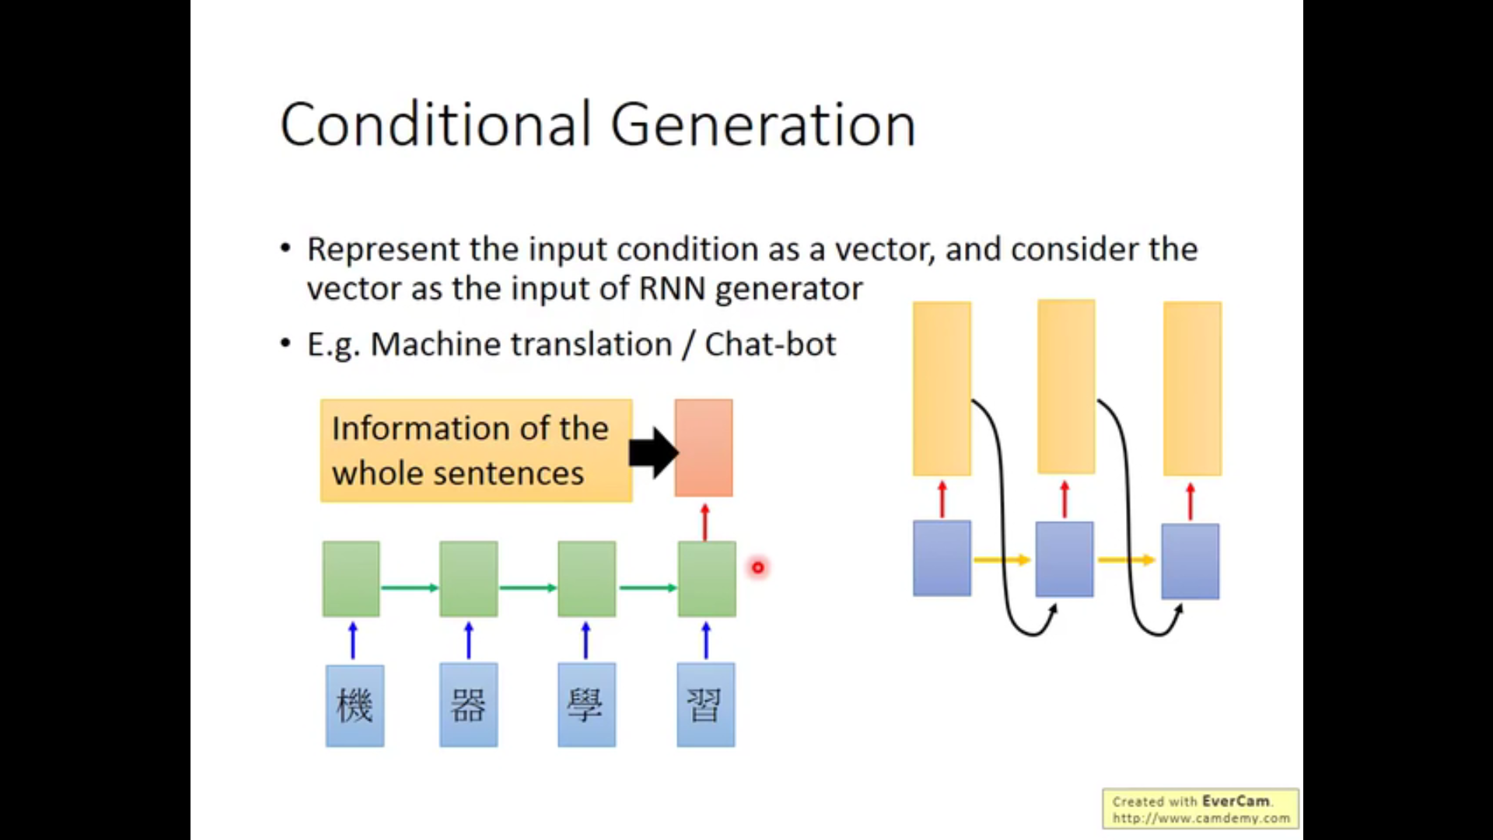

Slide 38
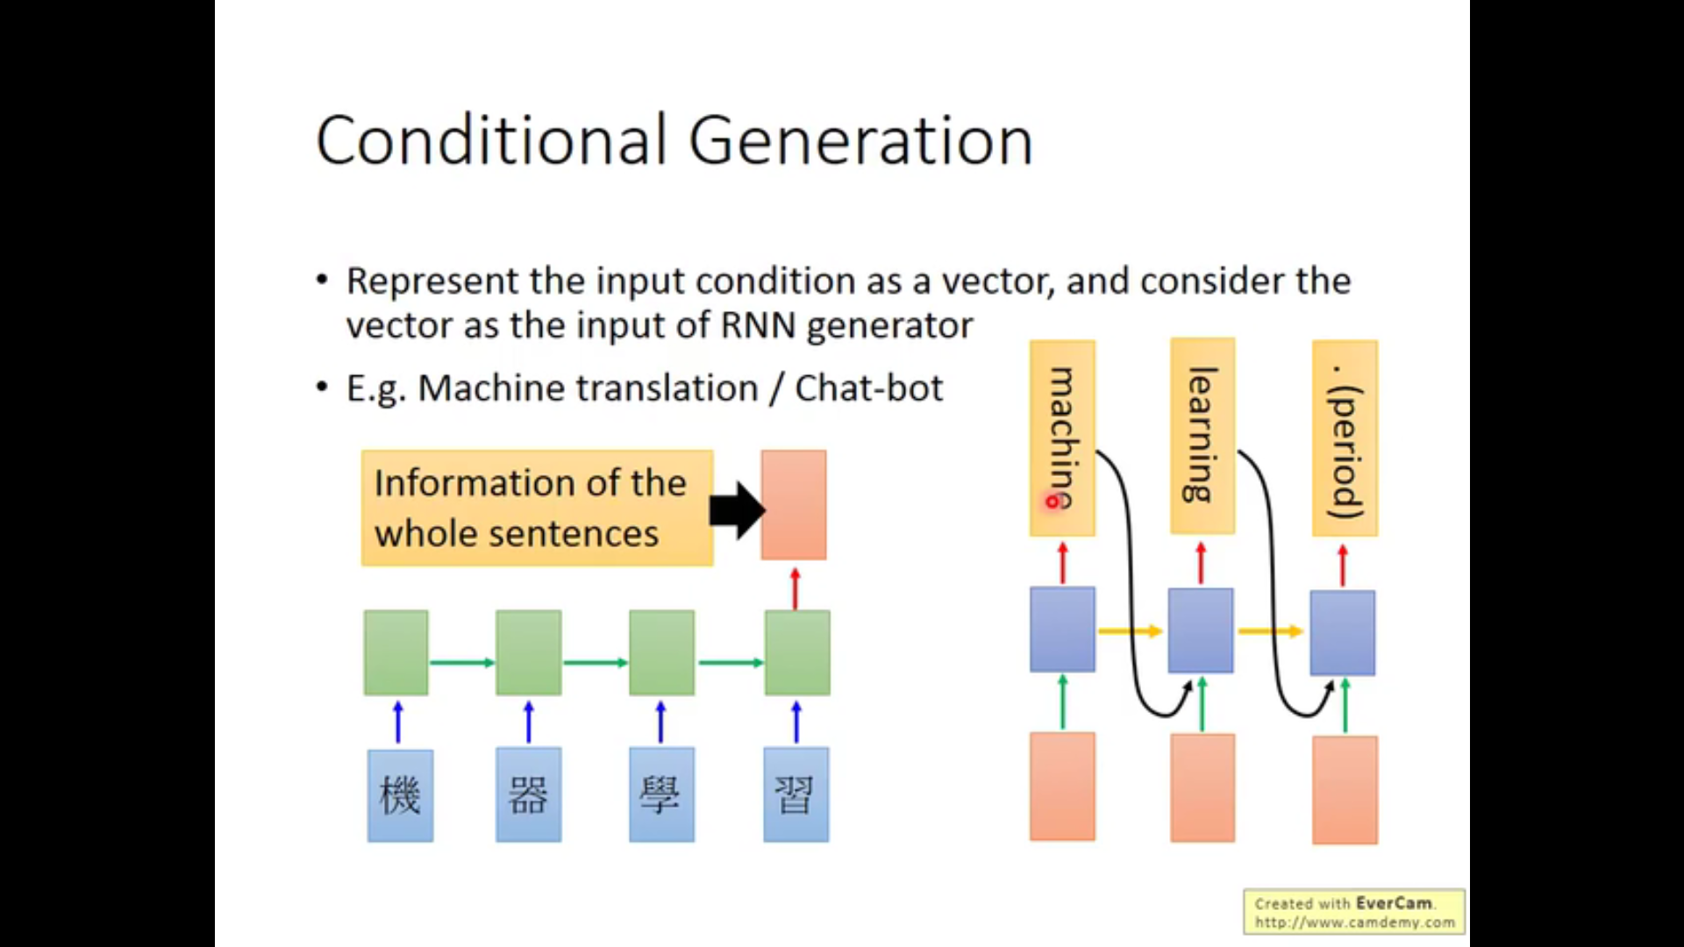

Slide 39
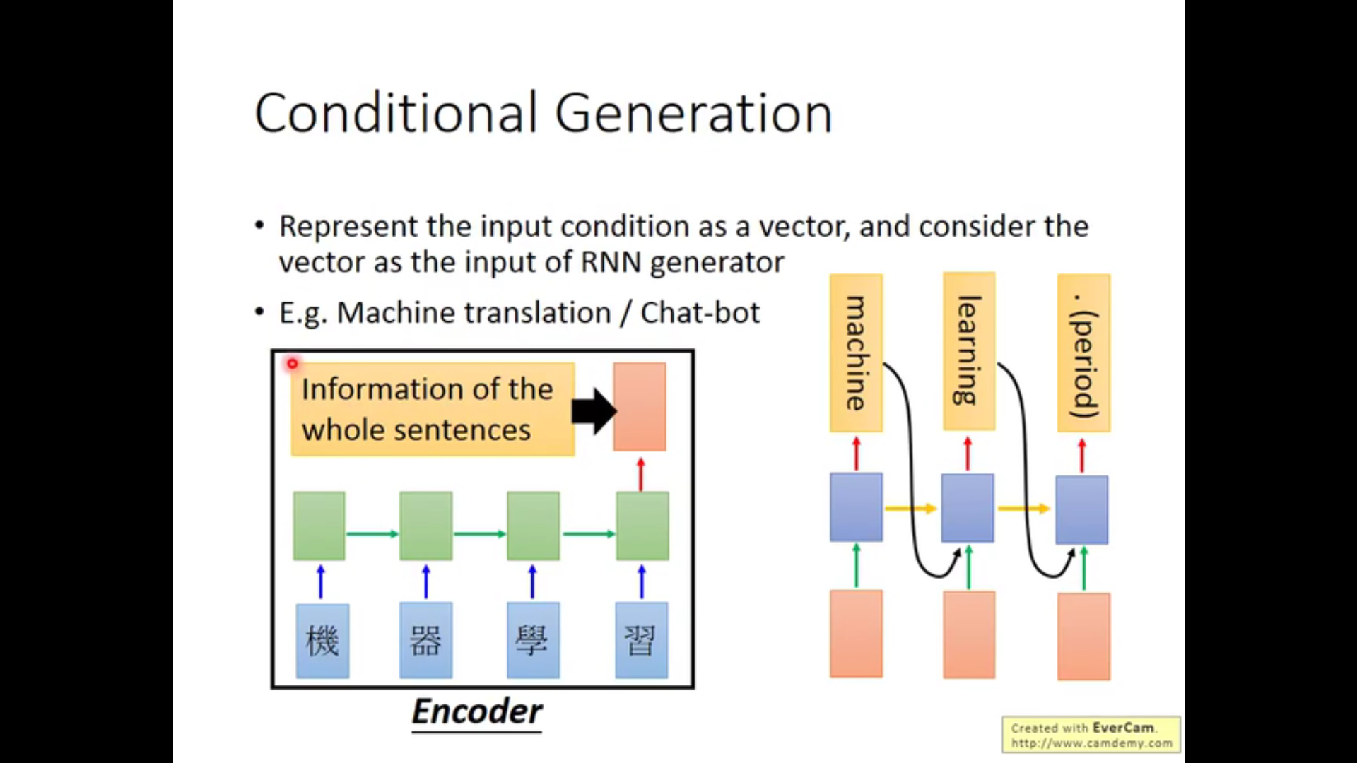

Slide 40
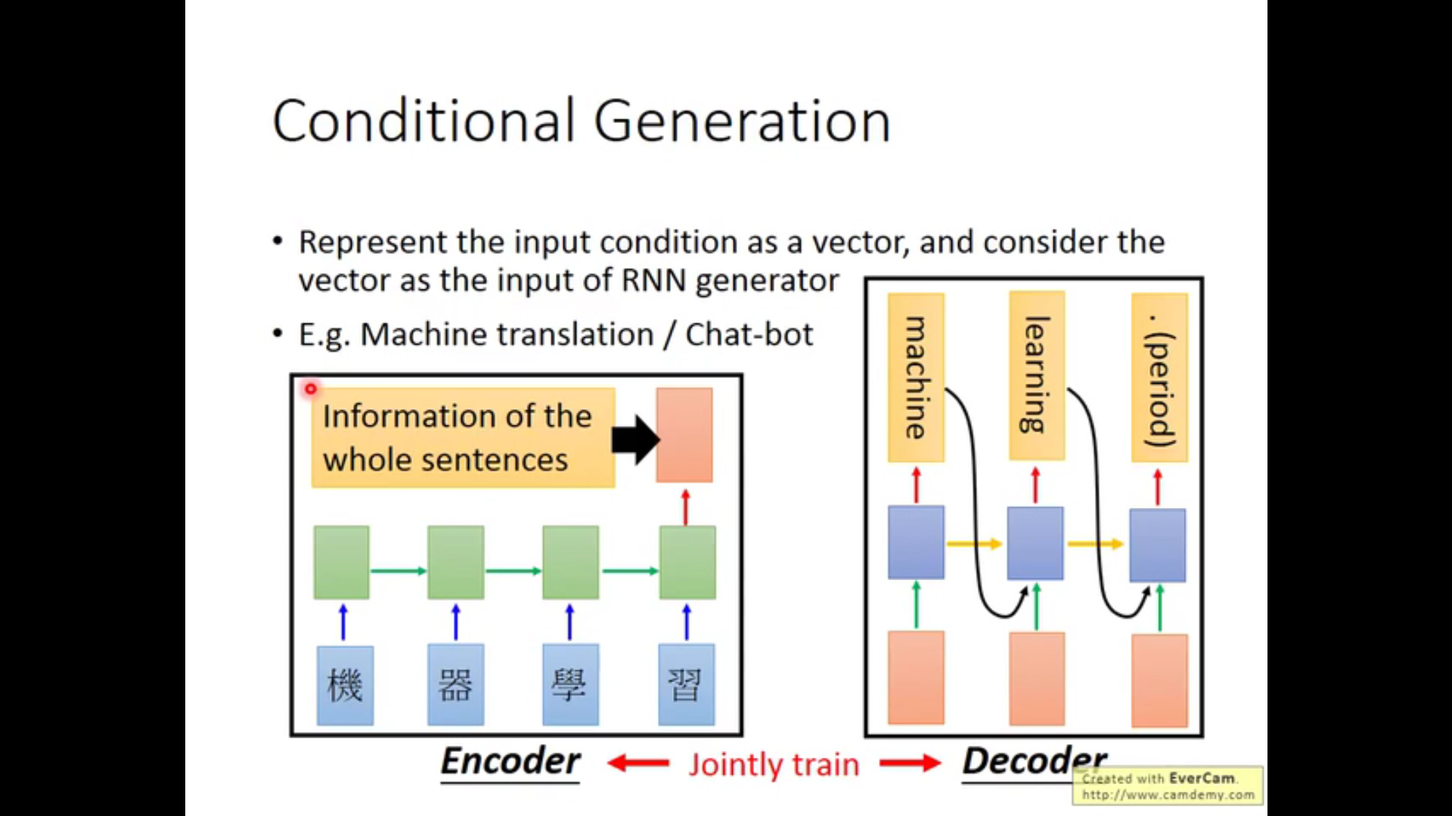

Slide 41
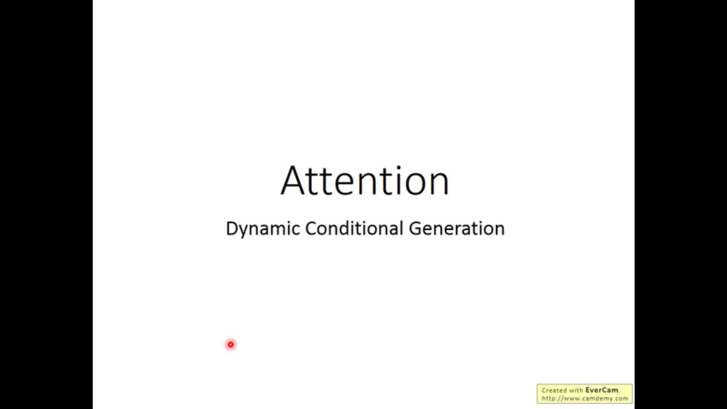

Slide 42
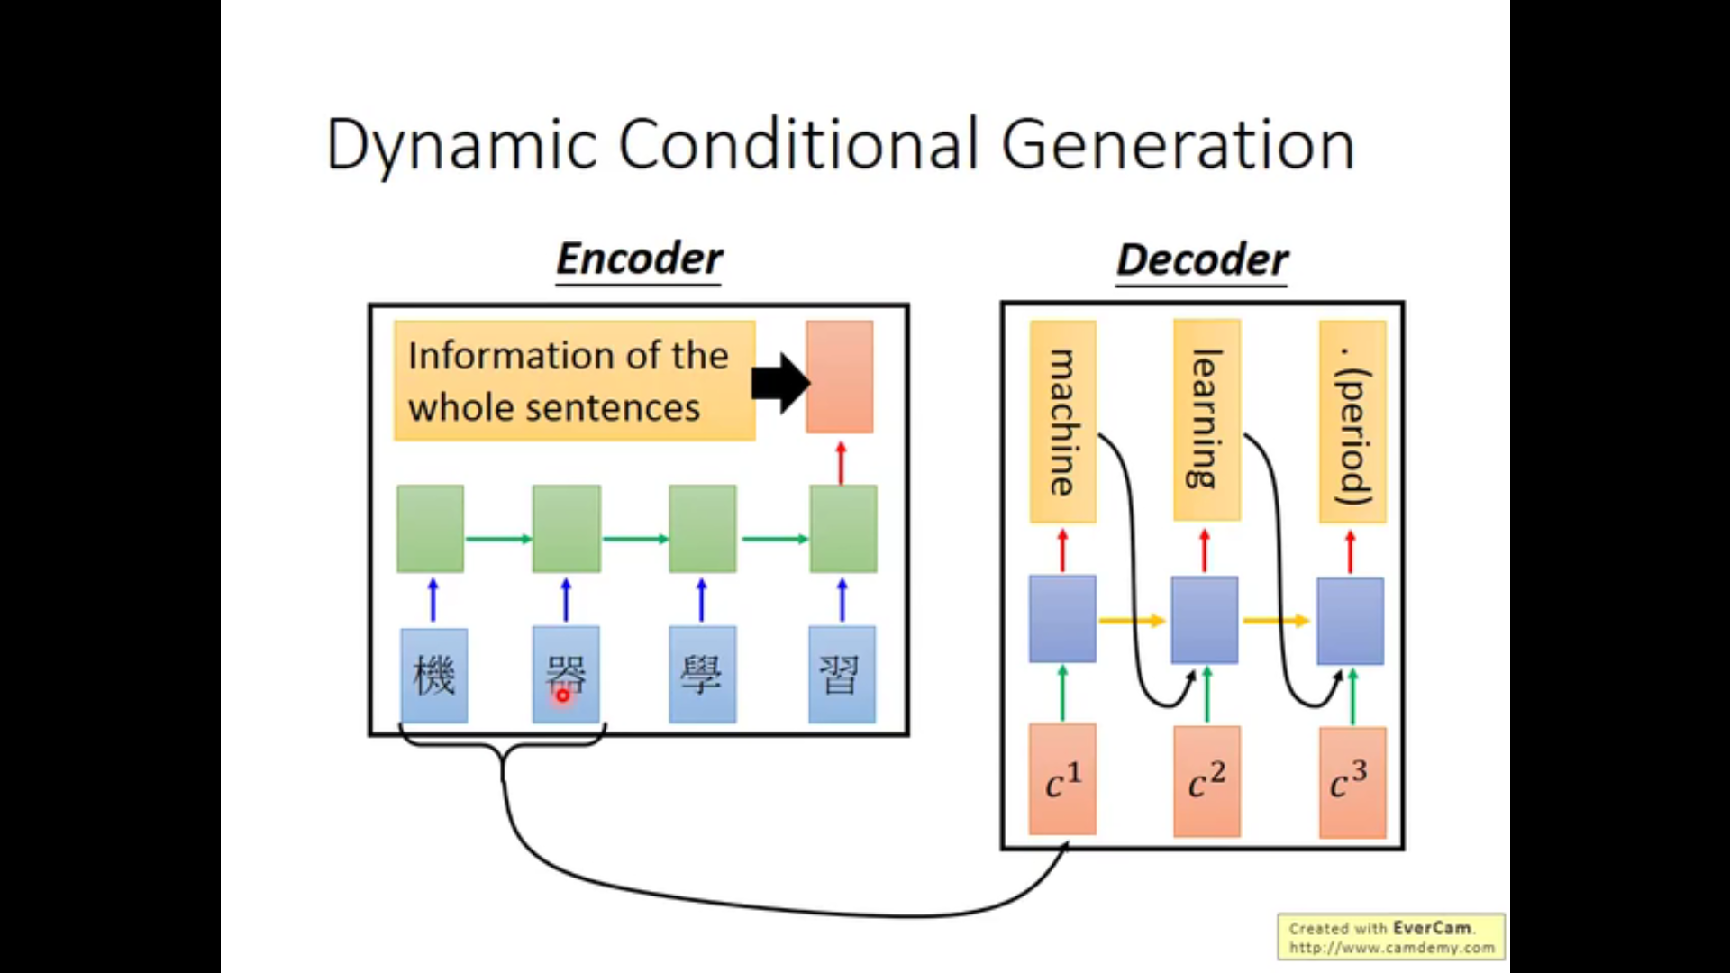

Slide 43
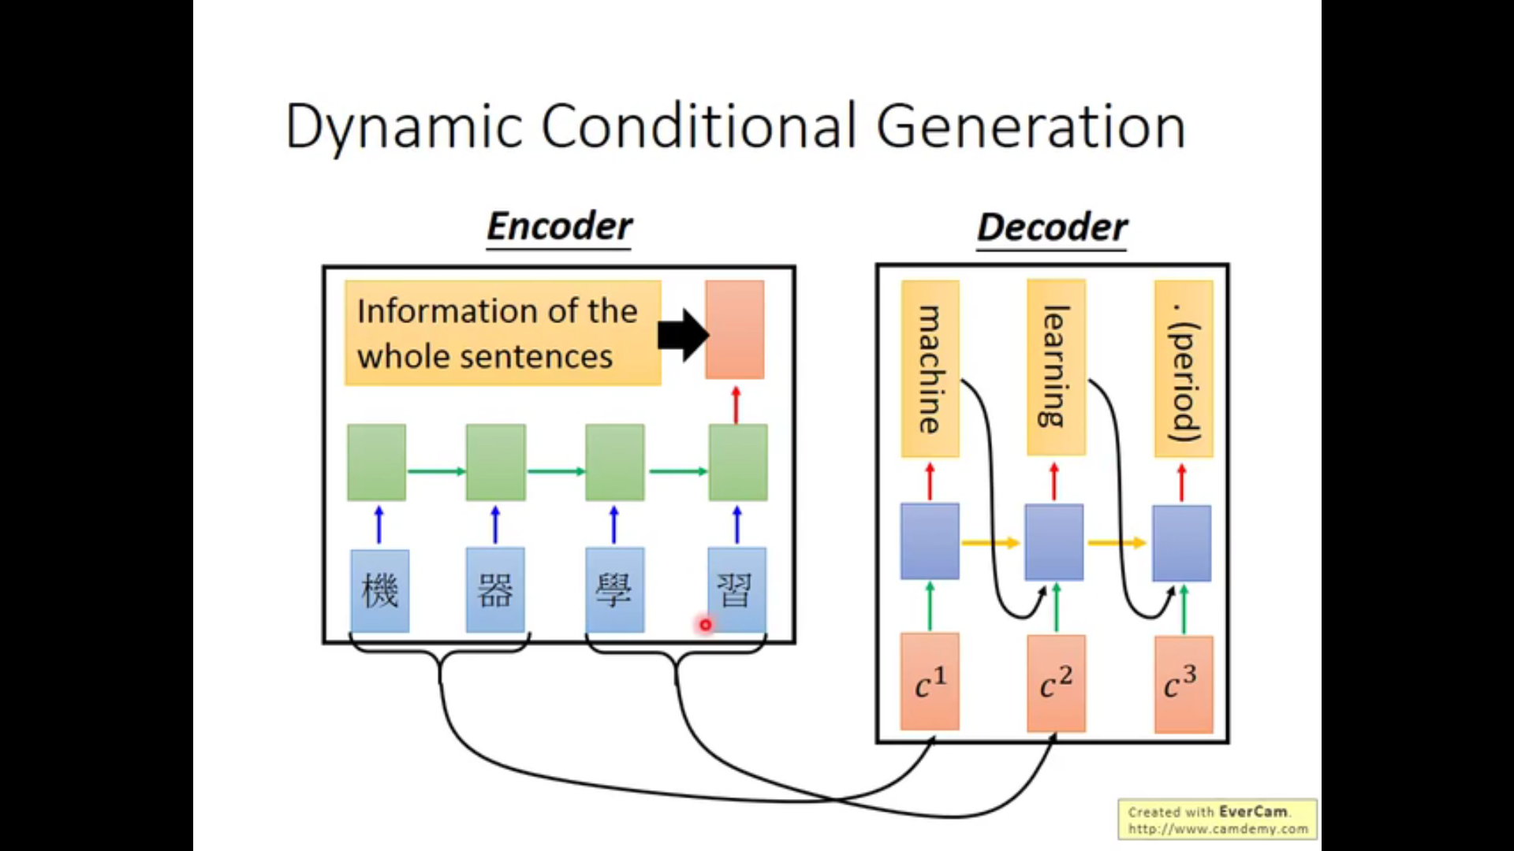

Slide 44
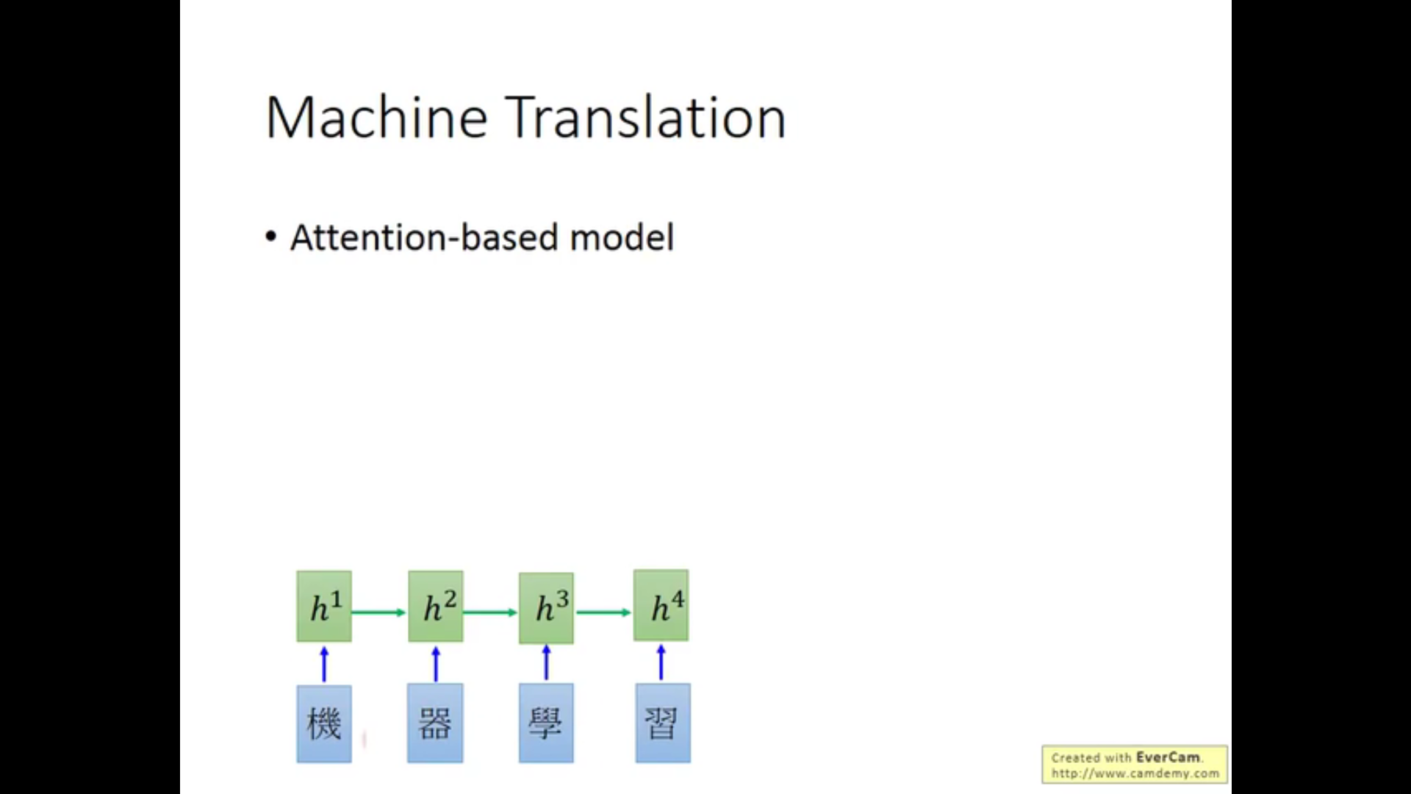

Slide 45
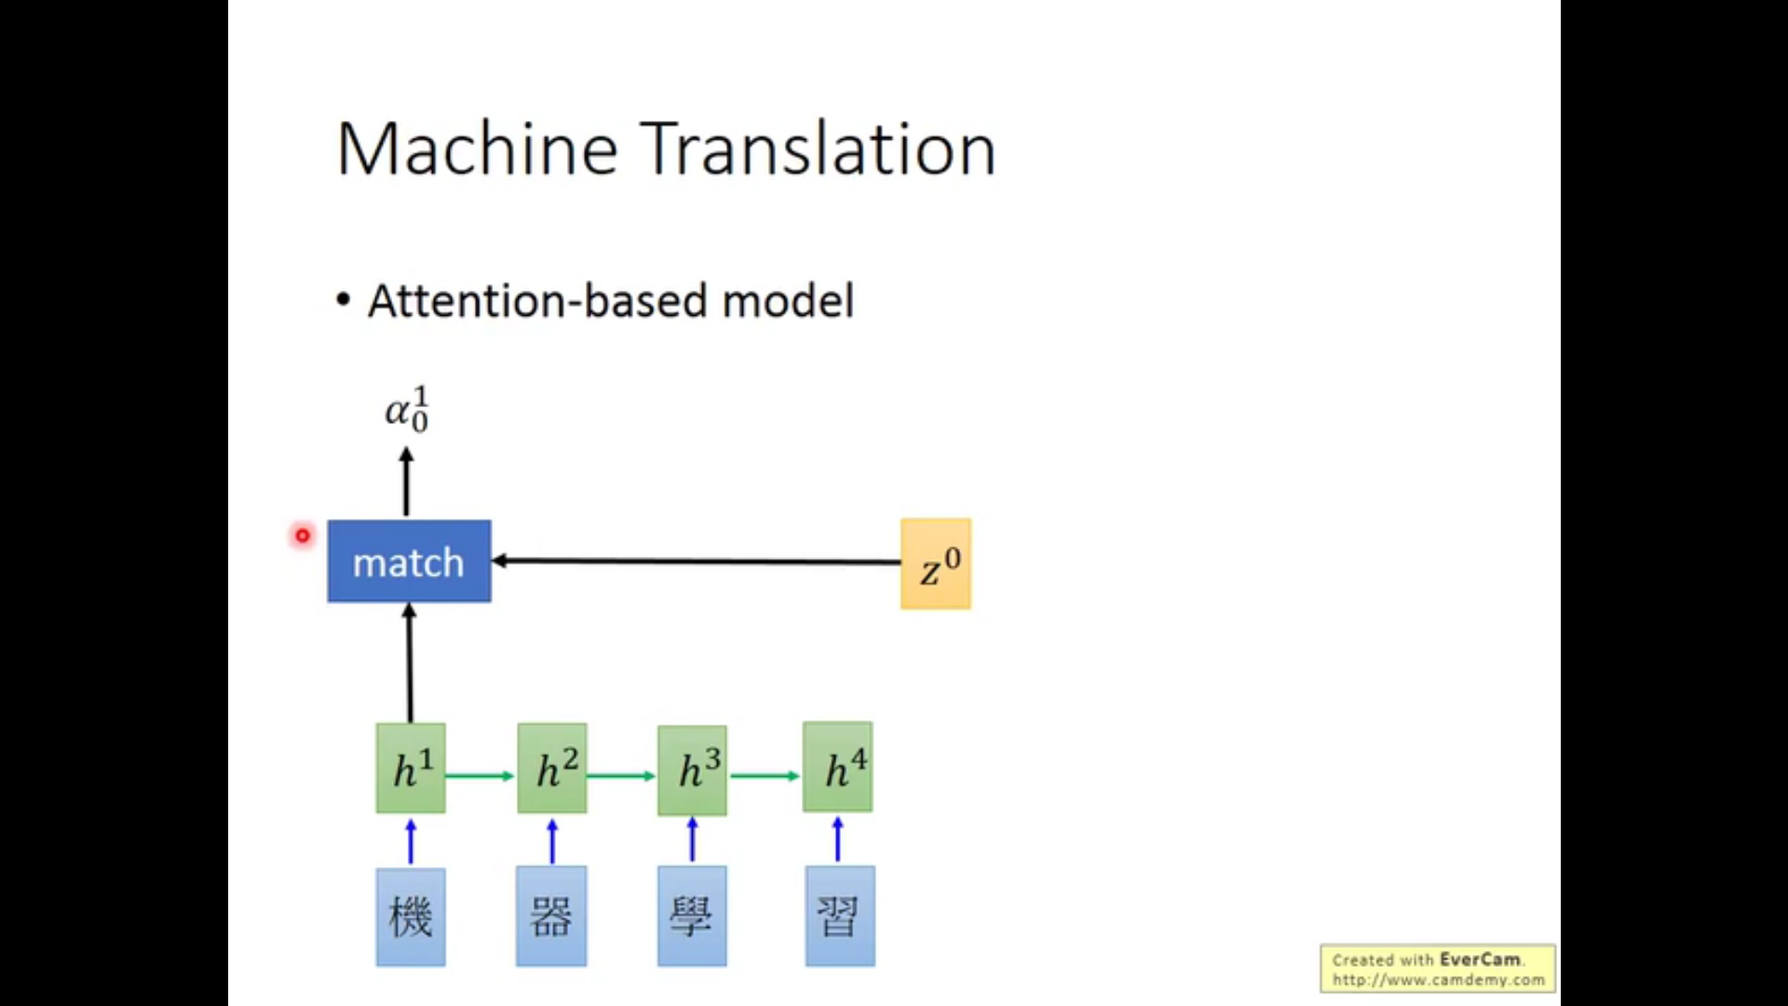

Slide 46
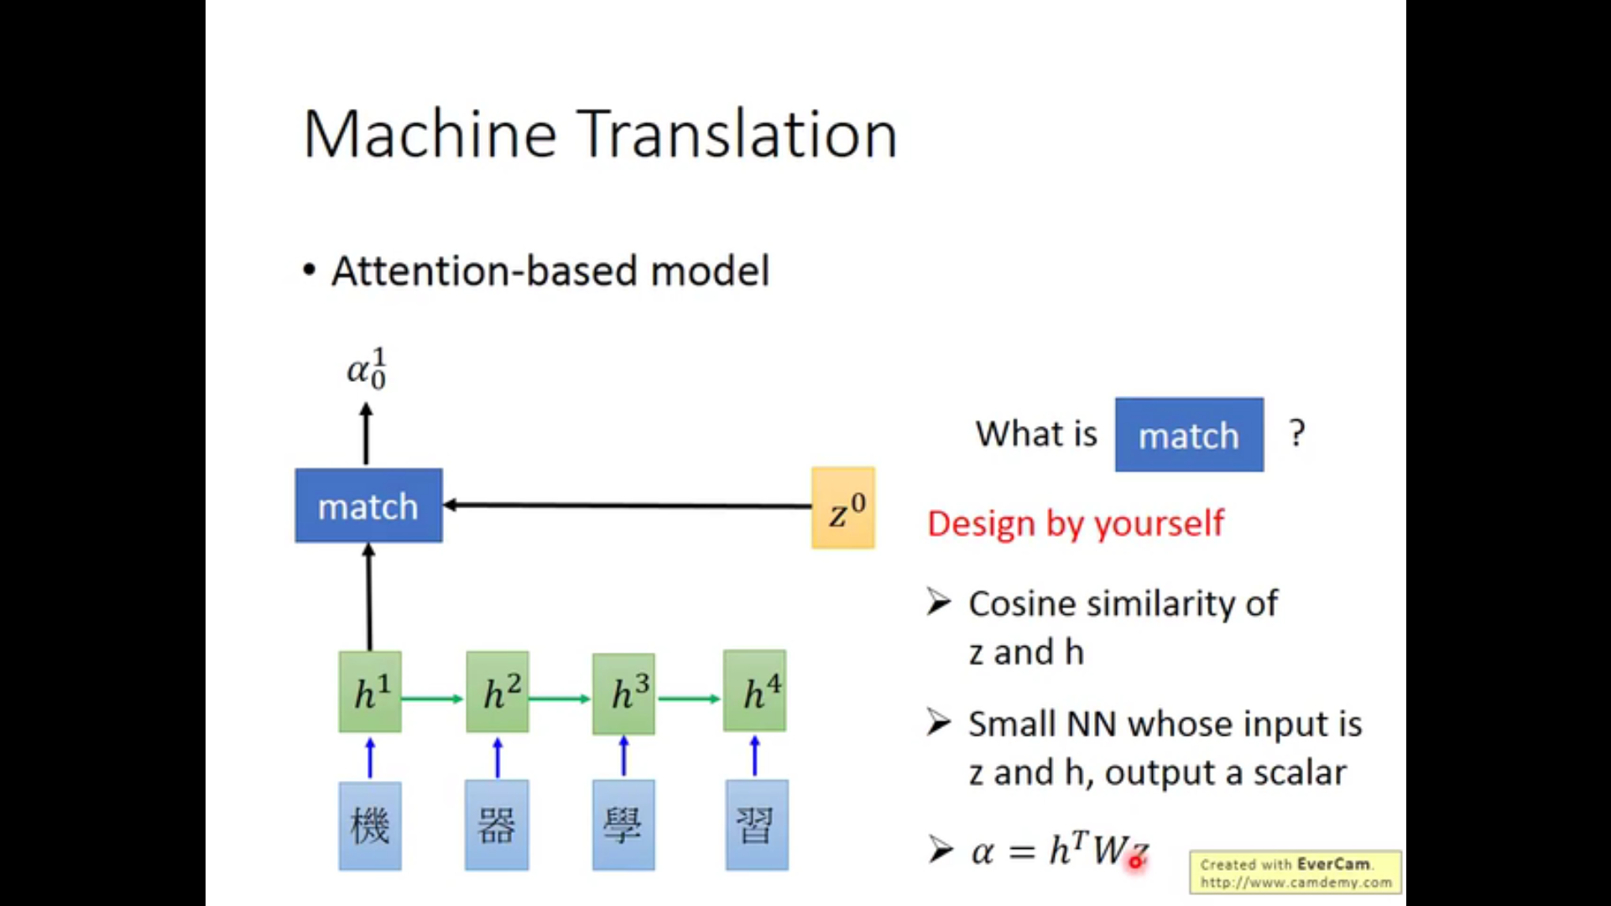

Slide 47
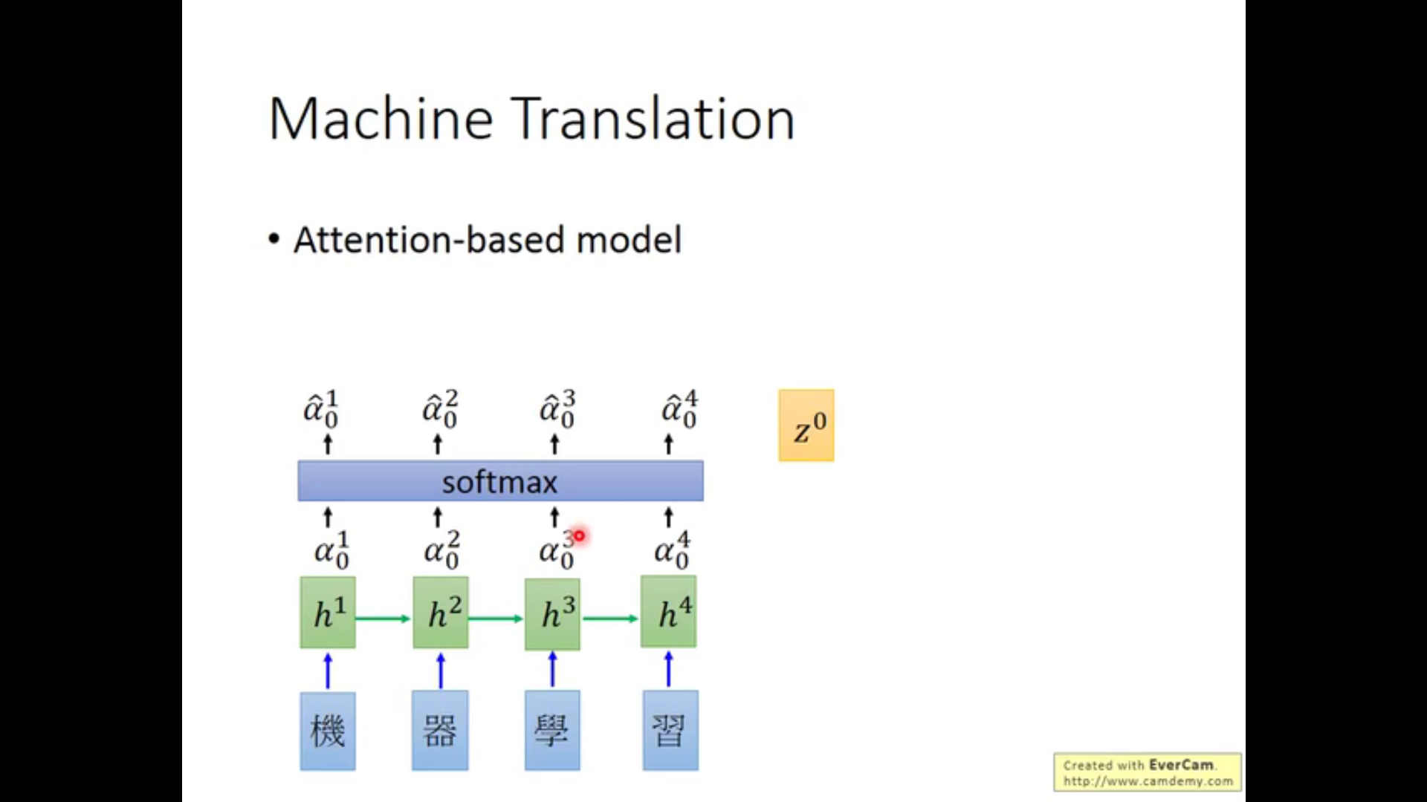

Slide 48


Slide 49


Slide 50


Slide 51


Slide 52


Slide 53


Slide 54


Slide 55


Slide 56


Slide 57


Slide 58


Slide 59


Slide 60


Slide 61


Slide 62
参考书目
https://www.bilibili.com/video/BV1Wv411h7kN?p=23
王东、利节和许莎，人工智能，清华大学出版社
吴飞，人工智能导论：模型与算法，高等教育出版社
https://colah.github.io/posts/2015-08-Understanding-LSTMs/
https://medium.com/inside-machine-learning/what-is-a-transformer-d07dd1fbec04
http://jalammar.github.io/illustrated-transformer/

Slide 63
谢谢！

